Slide 1
Training 2
Getting familiar with C++, sorting, recursion

Slide 2
Some general stuff

Slide 3
Fill up the survey, link in the email

Slide 4
71 days until Google Code Jam Qualification Round

Slide 5
About practice

Slide 6
Next training: Next Sat, 1:00pm to 3:30pm

Slide 7
Recap
#include <iostream>
using namespace std;
int main() {
cout << “Hello World!”;
}

Slide 8
More C++ stuff
Promise we’ll get to fun algorithms soon

Slide 9
Logic
&& - the ‘and’ operator
|| - the ‘or’ operator
The ternary operator
x = (statement) ? value1 : value2
If statement is true, x = value1.
Otherwise, x = value2

Slide 10
More arrays
Multi-dimensional arrays
int a[100][10] - creates a 100 x 10 array
Initializing arrays
int a[100] = {} - Initializes all elements to 0
int a[100] = {1, 2, 3} - Initializes first 3 elements to 1, 2, 3, and everything else to 0

Slide 11
Strings
Length of string
s.size()
cin >> s
Input = “the quick brown fox”. cin >> s. s = “the”
How to get multiple words / entire lines with cin?
getline(cin, s)
What exactly is cin?
It’s not a function
cin = character input stream
That’s why you use cin >> a. Input is directed into a.
This function takes a line from the input stream, and assigns it to s.

Slide 12
Comments
‘//’ - Add single line comments behind double slashes
‘/* ….. */’ - Multi-line comments

Slide 13
Functions
None of the questions last week required functions. Some of you guys were still curious enough to find out.

Slide 14
What the hell is int main()?
It’s a function!
Like variables, functions in C++ have types.
The type of a function is its return value
E.g. int, double, string

Slide 15
An example
int sumUp(int a, int b) { return a + b; }
Inputs to the function are placed within brackets
Inputs have a fixed type too

Slide 16
What if our function has no output?
void
Functions with no output are of the type ‘void’

Slide 17
Recursion
Finally. The fun stuff

Slide 18
What is recursion?
Recursion is when a function calls itself
You’ve probably learned from COMP 140/130. Sorry if you took 160.

Slide 19
An example - fibonacci
Definition of fibonacci sequence:
F0 = 0, F1 = 1
Fn = Fn-1 + Fn-2
What is wrong with this function?
int fib(int n) { return fib(n-1) + fib(n-2); }

Slide 20
Fibonacci continued
The sequence never stops! The base cases are missing
Correct fib function:
int fib(int n) {
if (n == 0) return 0;
if (n == 1) return 1; return fib(n-1) + fib(n-2); }

Slide 21
What is the time complexity of the fib function?
O(2^n)?
If, instead of Fn = Fn-1 + Fn-2, let Fn = Fn-1 + Fn-1
Clearly, this recursion is O(2^n)
Since the fibo function has strictly less operations than this, fibo is O(n^2)
Can we do better?
1.6180339887^n
Time complexity should be exponential. Let number of operations for Fn = a^n
Then, a^n = a^(n-1) + a^(n-2). (LHS comes from assumption, RHS comes from recursion)
Solving, a = (1+sqrt(5))/2 = 1.6180339887. The golden ratio!
We can rigorously prove this with induction

Slide 22
Sorting

Slide 23
Bubble Sort
Bubble sort repeatedly looks at each adjacent pair of integers from left to right. If the left integer is smaller than the right one, i.e. it is in the correct order, bubble sort leaves it alone. Otherwise, it swaps the two integers

Slide 24
Demo: Bubble Sort
1 9 2 5 3

Slide 25
Demo: Bubble Sort
1 2 9 5 3

Slide 26
Demo: Bubble Sort
1 2 5 9 3

Slide 27
Demo: Bubble Sort
1 2 5 3 9

Slide 28
Demo: Bubble Sort
1 2 3 5 9

Slide 29
Bubble Sort: an implementation
Simple, right? Here’s an implementation.
void bubbleSort(int arraySize, int arr[]) {
while (true) { // infinite loop
int swapsMade = 0;
for (int i = 0; i < arraySize - 1; i++) {
if (arr[i] > arr[i + 1]) {
swap(arr[i], arr[i + 1]); // useful swap function
swapsMade++;
}
}
if (swapsMade == 0) break; // the array is sorted.
}
}

Slide 30
Bubble Sort
What is the time complexity of bubble sort?
O(n^2)
How do you know that the array is sorted after O(n^2) operations?
Understand how the algorithm works
Every round, the larger elements are ‘bubbled’ up towards the end of the array.
The nth largest element is moved to its correct position
Therefore, the array must be sorted in n*n operations

Slide 31
Merge Sort
Bubble sort is slow
We need something more powerful
Merge sort is a recursive algorithm that is able to sort a list of integers in close to linear time, which means the runtime grows almost linearly to your input size.

Slide 32
Merge Sort
So how does merge sort work?
Picture the core operation of merge sort, the merge. In this case, it refers to the merging of two sorted arrays into one larger sorted array.

Slide 33
Merge Sort
Consider these two sorted arrays. How do I merge them efficiently?
1 2 3 5 9
3 4 5 7 8

Slide 34
Merge Sort
Realise the smallest element in both arrays must be the smaller element of either of the arrays.
1 2 3 5 9
3 4 5 7 8

Slide 35
Merge Sort
So we can start by removing that element and adding it into a new array.
- 2 3 5 9
3 4 5 7 8
1

Slide 36
Merge Sort
Repeat this process.
- - 3 5 9
3 4 5 7 8
1 2

Slide 37
Merge Sort
Repeat this process.
- - - 5 9
3 4 5 7 8
1 2 3

Slide 38
Merge Sort
Repeat this process.
- - - 5 9
- 4 5 7 8
1 2 3 3

Slide 39
Merge Sort
Repeat this process.
- - - 5 9
- - 5 7 8
1 2 3 3 4

Slide 40
Merge Sort
Repeat this process.
- - - 5 9
- - - 7 8
1 2 3 3 4 5

Slide 41
Merge Sort
Repeat this process.
- - - - 9
- - - 7 8
1 2 3 3 4 5 5

Slide 42
Merge Sort
Repeat this process.
- - - - 9
- - - - 8
1 2 3 3 4 5 5 7

Slide 43
Merge Sort
Repeat this process.
- - - - 9
- - - - -
1 2 3 3 4 5 5 7 8

Slide 44
Merge Sort
Done! This takes linear time, because it only runs through each integer once!
- - - - -
- - - - -
1 2 3 3 4 5 5 7 8 9

Slide 45
Merge Sort
So how do we apply this to sort an entire random list of numbers?
Remember recursion? :)
Let’s revisit that concept.
I don’t know how to sort an entire array, but I know how to merge two sorted arrays. So...?

Slide 46
Merge Sort
I can split the array into two, and make an instance of the same function sort the left array, and another instance of the same function sort the right array, and MERGE THEM! :D
So, what’s the base case?
An array with one integer is always sorted, so we can end the recursion when we reach one integer.

Slide 47
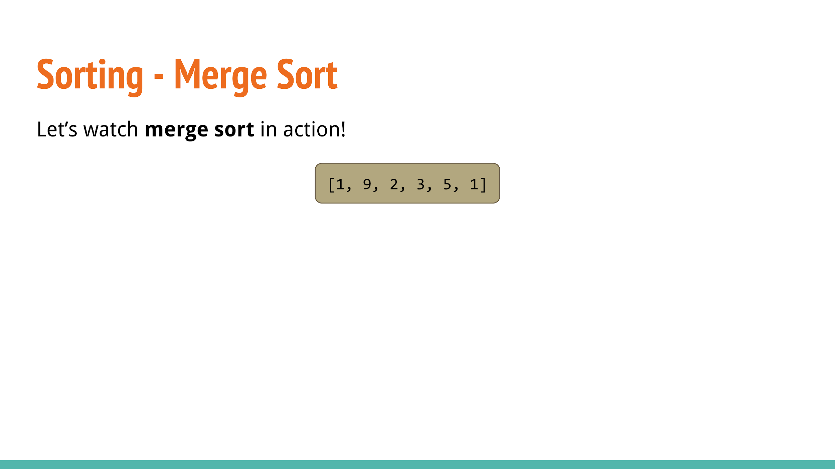

Slide 48
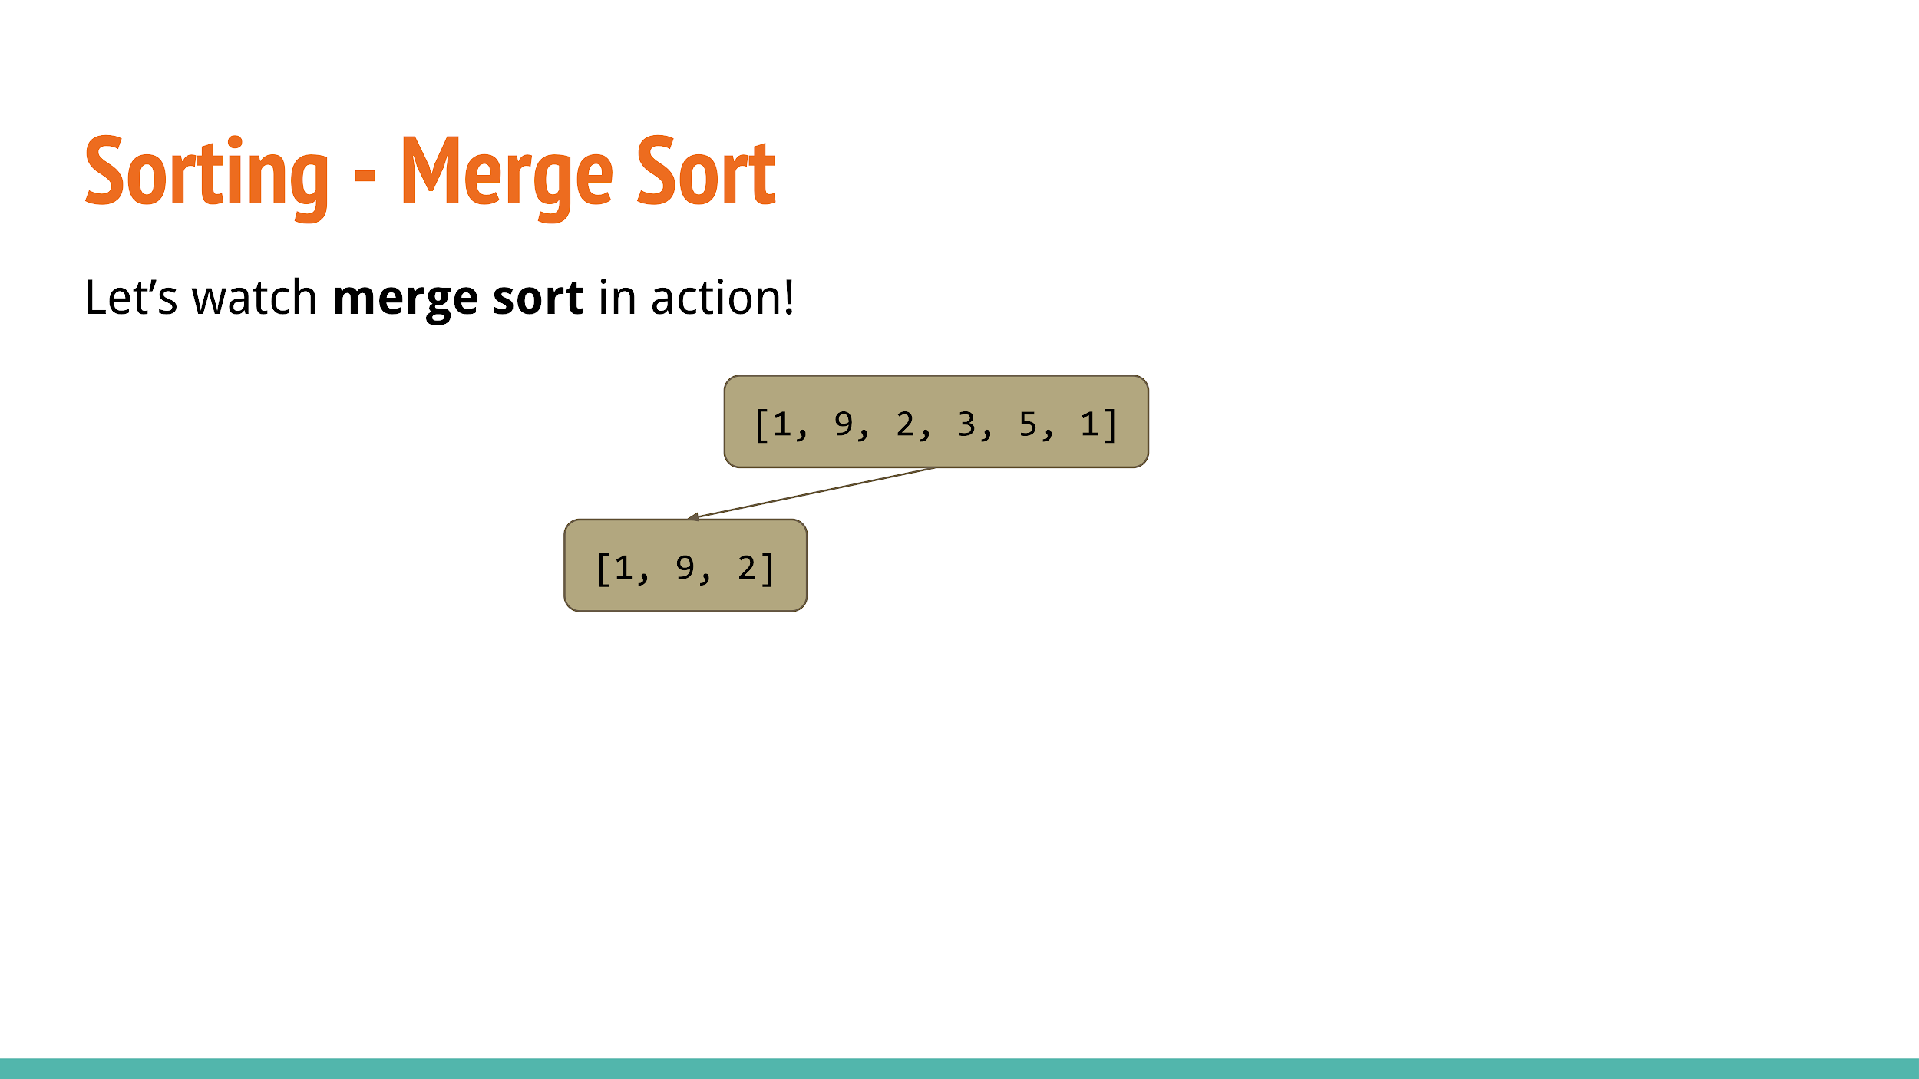

Slide 49
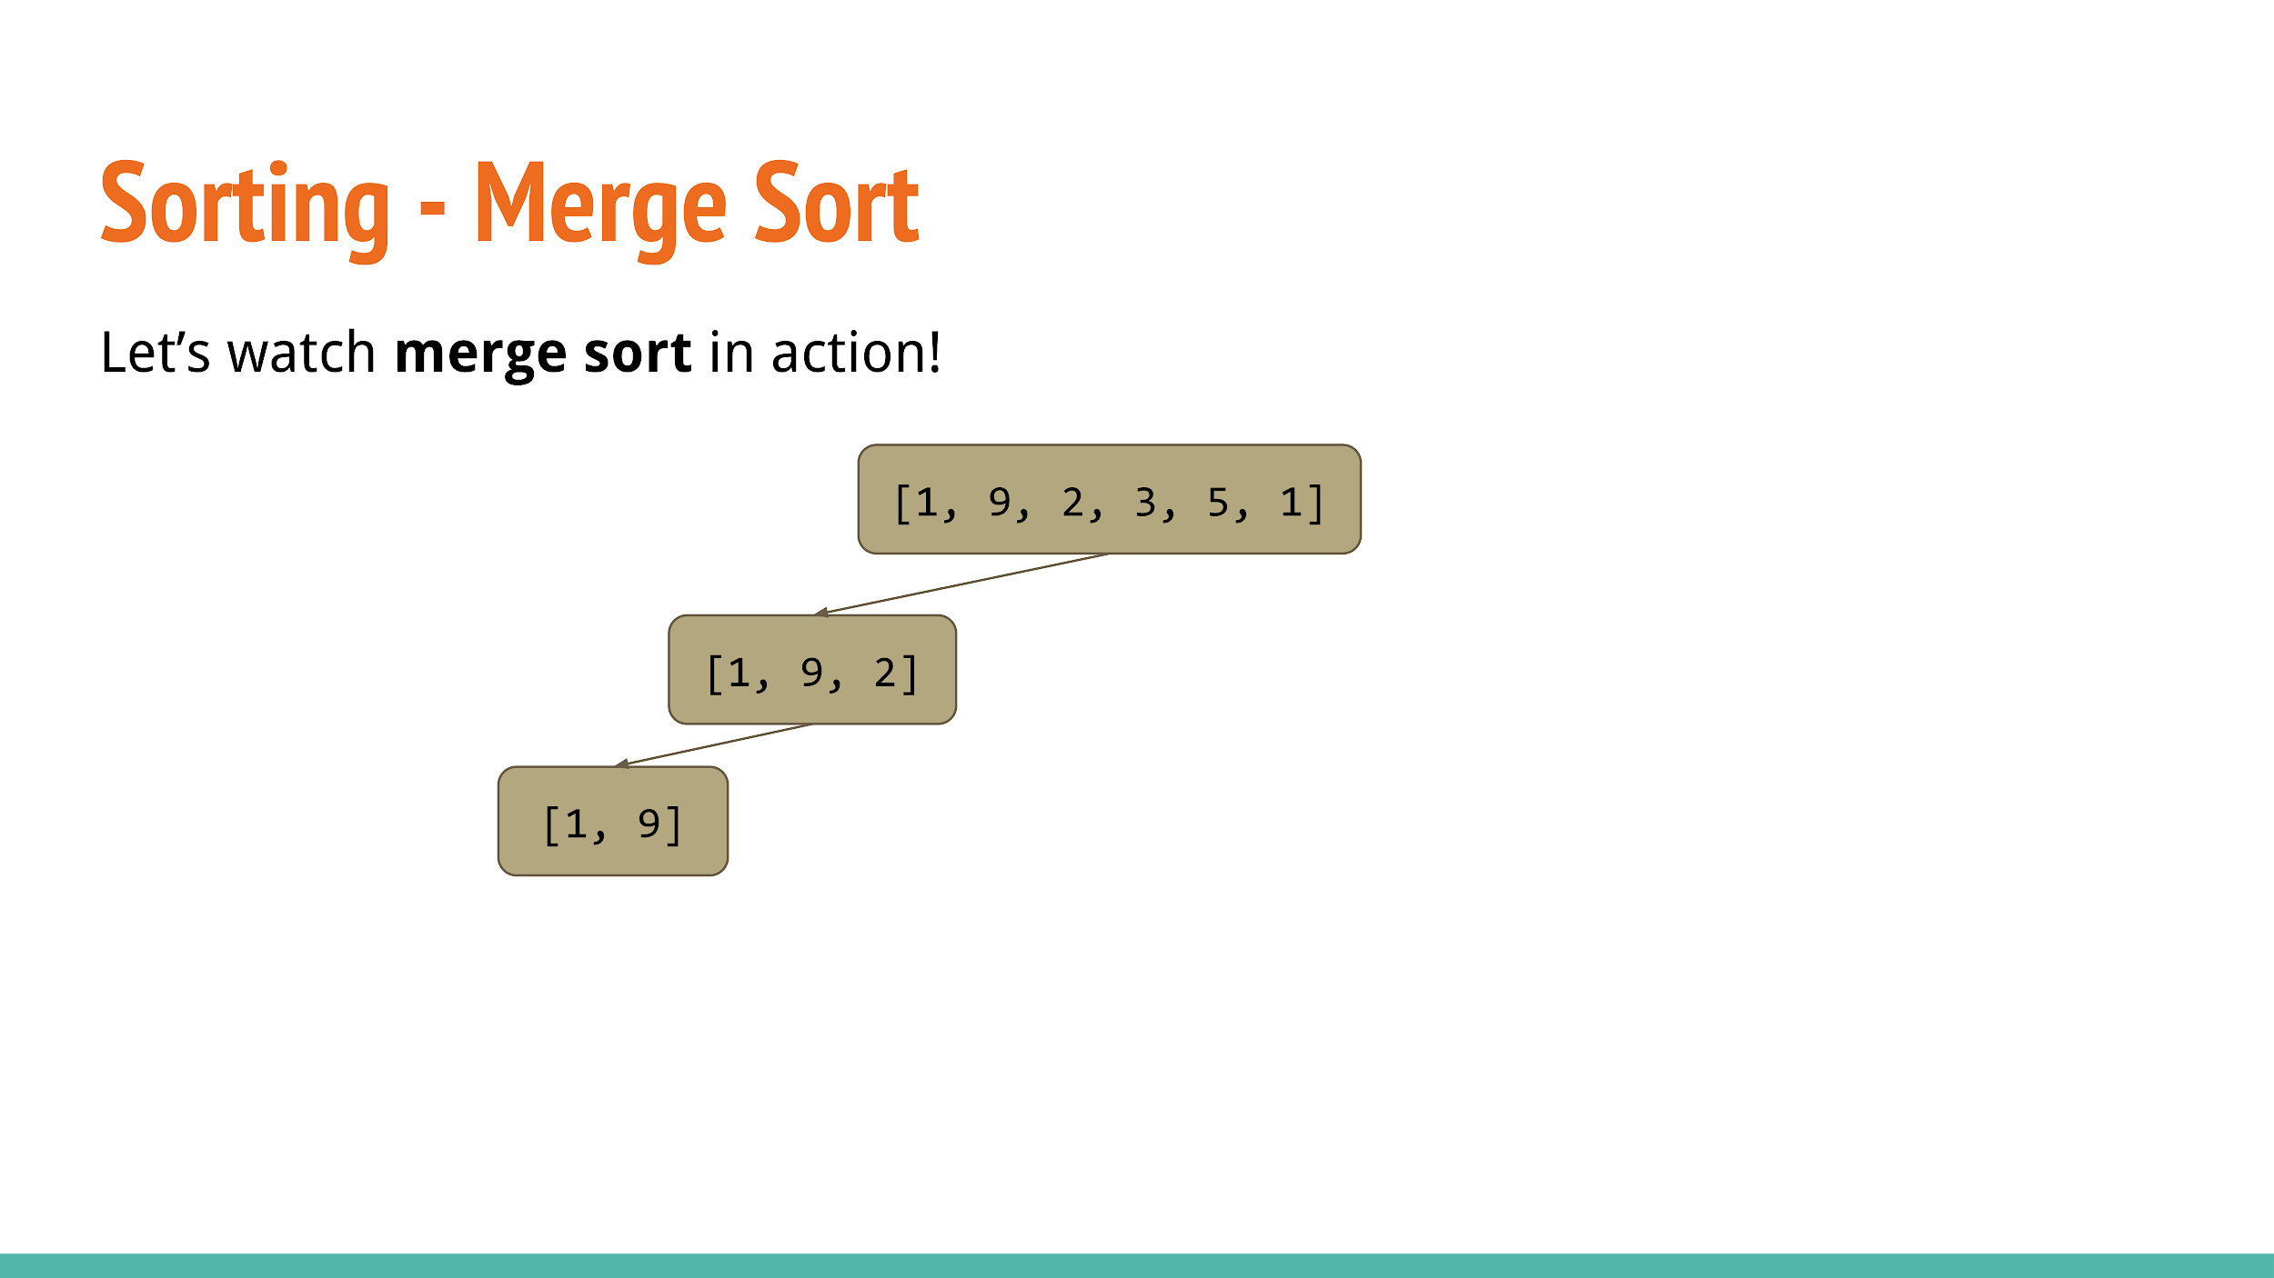

Slide 50
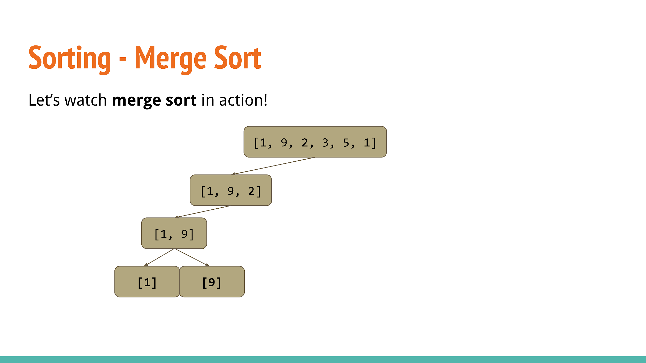

Slide 51
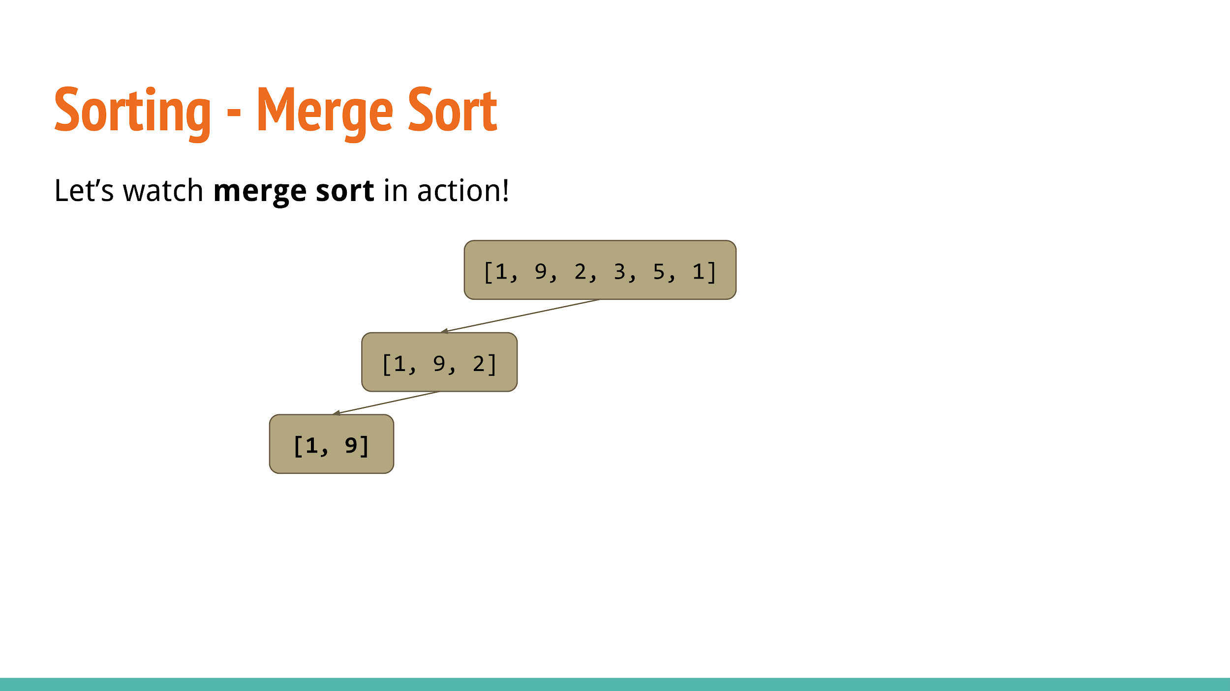

Slide 52
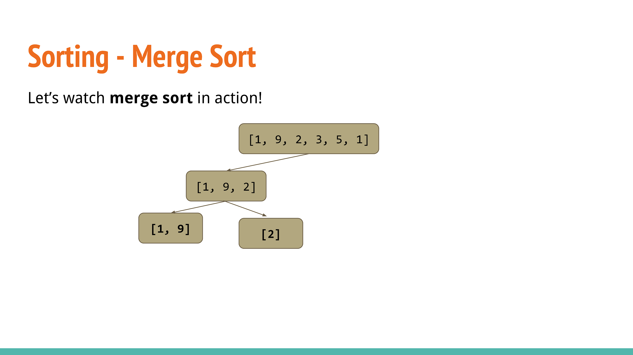

Slide 53


Slide 54
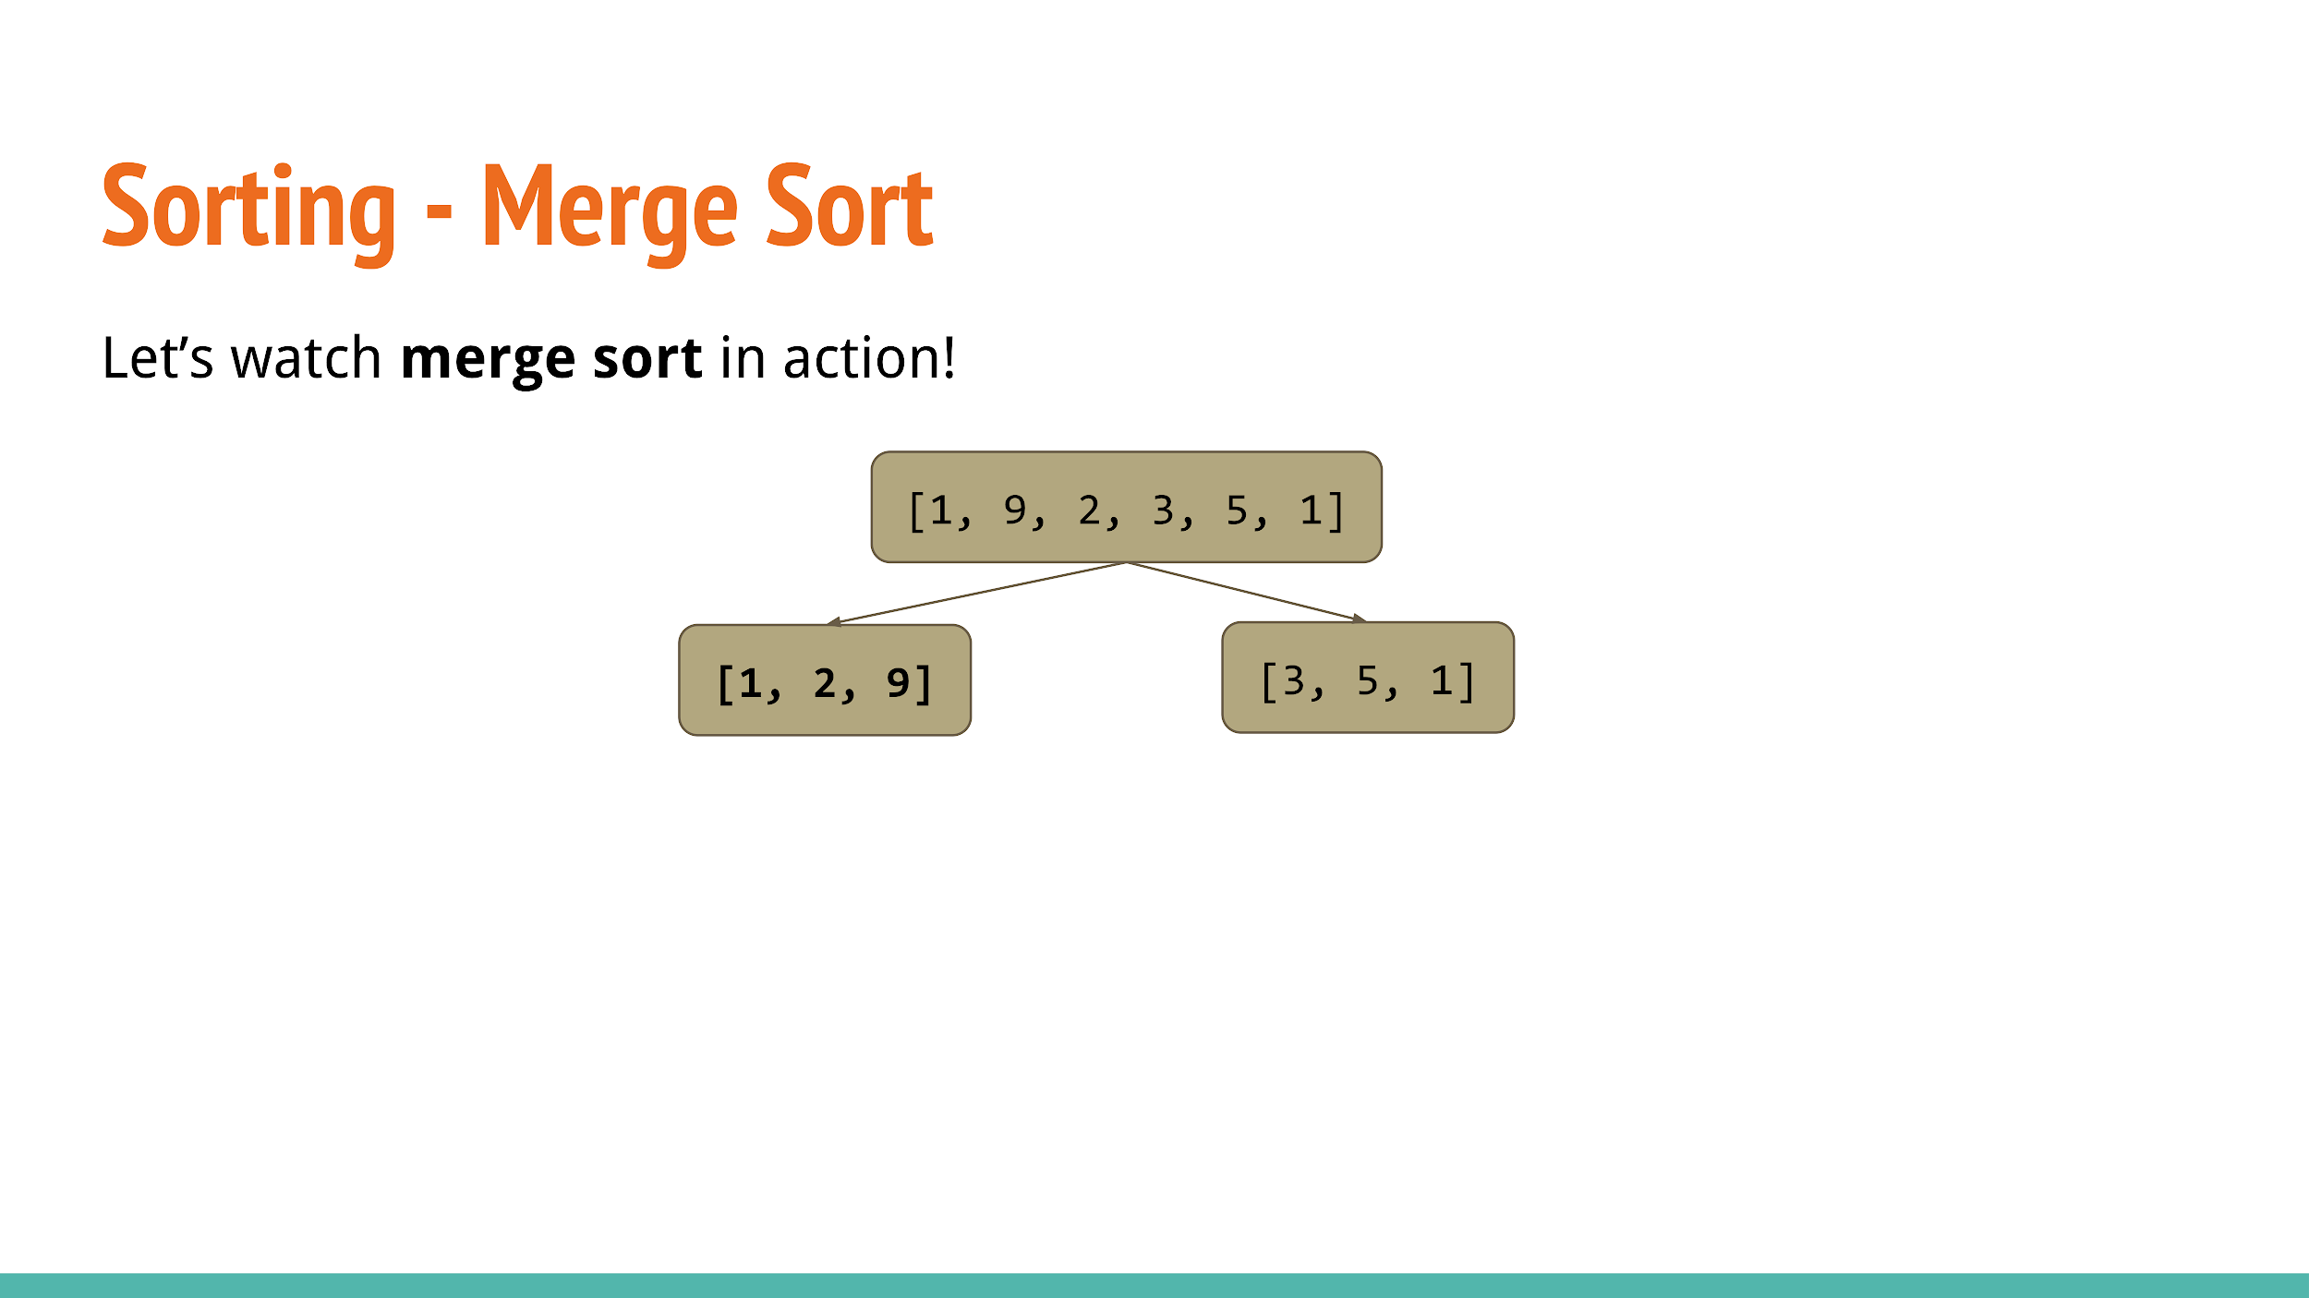

Slide 55
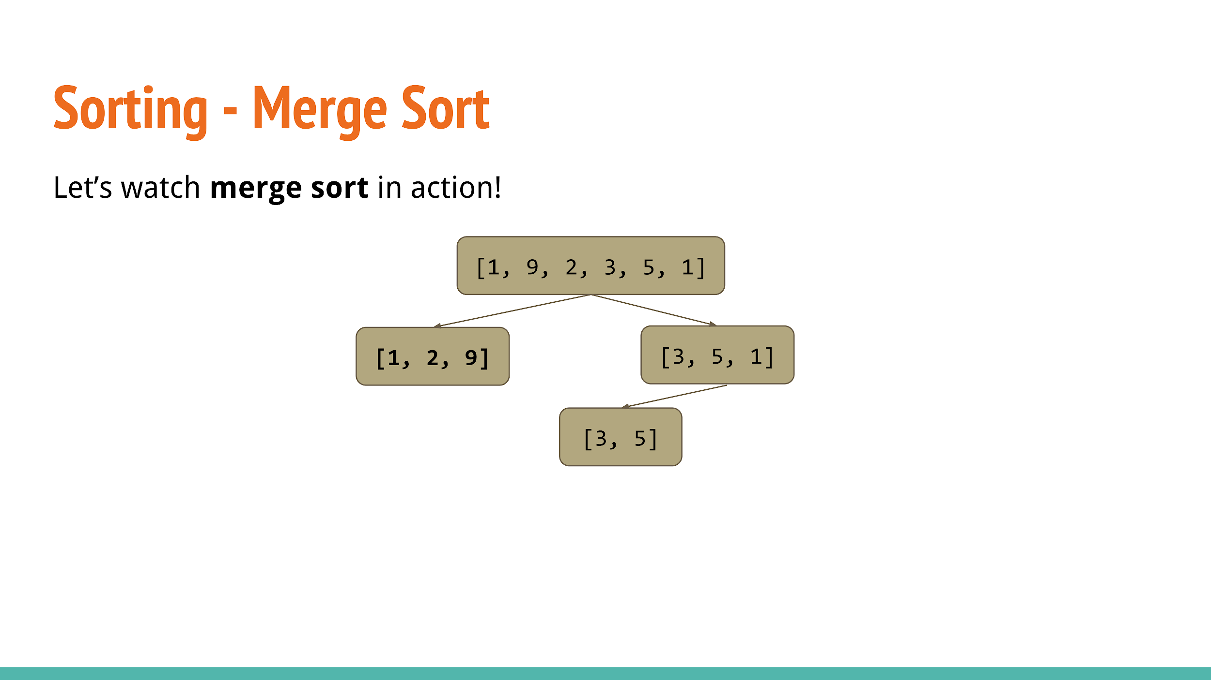

Slide 56
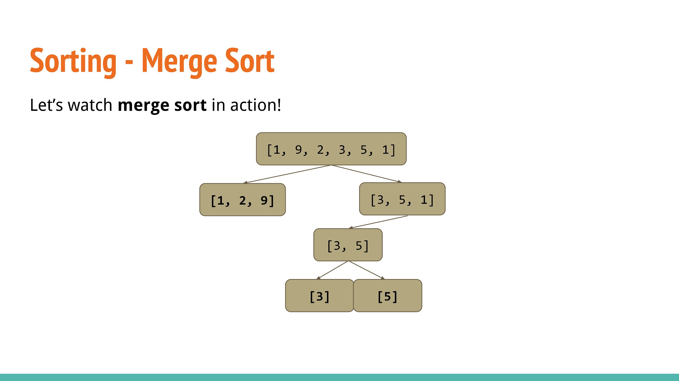

Slide 57


Slide 58
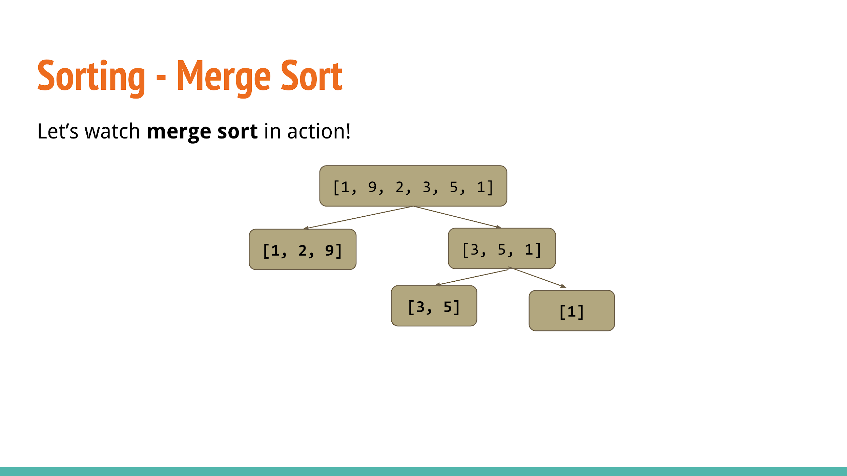

Slide 59


Slide 60


Slide 61
MergeSort: an implementation
void mergeSort(int start, int end, int arr[]) {
if (start + 1 == end) return; // 1-integer array
int mid = (start + end) / 2; // split by midpoint
mergeSort(start, mid, arr);
mergeSort(mid, end, arr);
int arr2[end - start]; // declare an array with correct size
int pos1 = start, pos2 = mid; // start positions of both arrays
for (int i = 0; i < end - start; i++) {
if (pos1 == mid || (pos2 != end && arr[pos2] < arr[pos1])) {// if left array is empty or greater
arr2[i] = arr[pos2]; // set the new array position to first element of right array
pos2++;
} else {
arr2[i] = arr[pos1]; // else, set new array position to first element of left array
pos1++;
}
}
for (int i = 0; i < end - start; i++) arr[i + start] = arr2[i]; // put sorted array back
}

Slide 62
STL Sort
Don’t worry, you don’t have to implement your own sorting algorithm.
C++ has a sort() function.
sort(arr, arr+ arraySize);

Slide 63
What is the time complexity of merge sort?

Slide 64
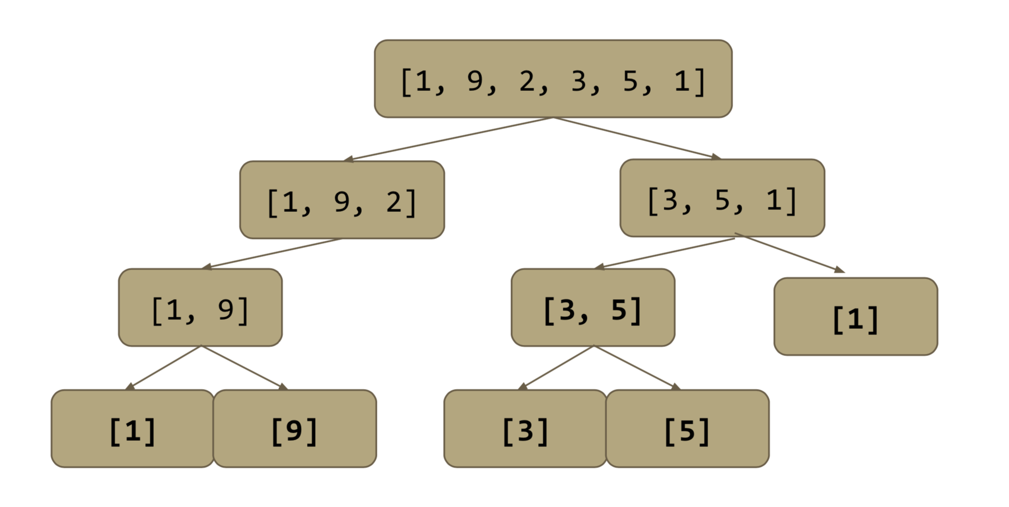
Merge Sort - time complexity
Let’s look at this diagram.
Remember that each merge operation is O(N) to the number of elements merged.

Slide 65
Merge Sort - time complexity
Notice that since the array is split into 2 parts each time, the maximum height of the tree will not exceed approximately log₂N.

Slide 66
Merge Sort - time complexity
Therefore, each integer will be merged at most log₂N times. Since each merge takes O(1) per integer and there are N integers, the entire algorithm takes
O(N log₂N) time, which we often shorten to just O(N lg N) time.

Slide 67
Time complexity
The time complexity of your algorithm is incredibly important
Usually, problems have a time limit of 1 second.
Around 100 million operations
A O(n^2) algorithm should only be used on input size < 10000
A O(n log n) algorithm should only be used on input size < 5,000,000
log n is around 20
Of course, the constant c also matters greatly
Different data structures are more efficient
Sorting a vector is faster than inserting into a map (balanced binary tree), though they are both O(n log n)

Slide 68
Time for practice!

